Slide 1
April 25, 2023

Slide 2

Gentle Introduction to Machine Learning: Regression
A Reproducible Research Workshop
Simon Stone
Research Data Services
Dartmouth College

Slide 3
About the Reproducible Research Group
Joint venture of Research Computing @ ITC and Research Data Services @ Library
Consult with experts on
research data management,
data visualization,
biomedical research support,
spatial data and GIS,
high performance and research computing,
statistical analysis,
economics and social sciences data
Meet the people on campus that support your reproducible research lifecycle
Engage in community discussions to learn from other researchers on campus
Attend a workshop to learn practical tools and tips

Slide 4
About Research Data Services
Research Data Management
Data Management Plans (DMPs) for sponsored projects
Finding and using 3rd party data
Collection and cleaning of data
Organization and documentation
Publishing and Repositories
Data Analysis/Visualization
Textual, numeric, spatial data
Reproducible research workflows
Scripting in R: tidyverse core package (i.e., ggplot, dplyr, tydr, tibble, etc.)
Scripting in Python: NumPy, SciPy, Pandas, Scikit-learn, Matplotlib, Seaborn, (OpenCV, PyTorch, TensorFlow, Tesseract, NLTK, etc.)
Computational Scholarship
Computational project planning
Collections as Data
Storytelling with data and visualizations
Text and data mining
Digital Humanities support
Computational Pedagogy

Slide 5
Work with us
ResearchDataHelp@groups.dartmouth.edu
Jeremy Mikecz Research Data Science Specialist jeremy.m.mikecz@dartmouth.edu dartgo.org/jeremyappts | Simon Stone Research Data Science Specialist simon.stone@dartmouth.edu dartgo.org/meetwithsimon
Lora Leligdon Head of Research Data Services lora.c.leligdon@dartmouth.edu dartgo.org/lora

Slide 6
Gentle Introduction to Machine Learning Intro
Machine Learning is ”the field of study that gives computers the ability to learn without explicitly being programmed.”
- Arthur Samuel, 1959 (paraphrased)
Machine Learning
Deep Learning
Artificial General Intelligence
Machine Learning is what we should call (the current) Artificial Intelligence!

Slide 7
Gentle Introduction to Machine Learning Intro
Aims of this series:
Demystify the field a bit and give context to the buzzwords
A working mental model how machine learning algorithms think calculate
To provide enough knowledge to think critically about “A.I.”
To inspire you to confidently use machine learning in your work and personal life

Slide 8
Gentle Introduction to Machine Learning Intro
Statistics (April 12)
A brief survey of the fundamentals for Machine Learning
Regression (April 25)
How can an algorithm find relationships between two variables?
Classification (May 9)
How can an algorithm put a label on a real-world object?

Slide 9
Gentle Introduction to Machine Learning Intro
Feedback from Intro to Statistics:
Generally very positive
Most frequent request: More ”how”, more math!

Slide 10
Basics Intro
Every machine learning model, ever:
Trained model:
Mystery Box
Input data
Output data

Slide 11
Basics Intro
Training process:
Choose a model structure for your problem
Every model has parameters that can be changed to better fit the problem at hand
Show the model plenty of data
Adapt the model’s parameters to best fit the data
Challenge: How do we know what is the “best fit”?

Slide 12
Basics Intro
Every machine learning model, ever:
Evaluation ⚖️
🔧
During Unsupervised Training:
Mystery Box
Training data
Output data

Slide 13
Basics Intro
Every machine learning model, ever:
During Supervised Training:
Mystery Box
Training data
Output data
Training labels
🔧
Evaluation ⚖️

Slide 14
Gentle Introduction to Machine Learning Intro
Supervised Learning
Classification
Regression
Unsupervised Learning
Clustering
Anomaly Detection
Semi-supervised Learning
Mix of labeled and unlabeled data
Self-supervised Learning
Language modeling

Slide 15
Gentle Introduction to Machine Learning Outline
What is “regression”?
Best-fit regression models: Linear Regression
Similarity-based regression models: k-Nearest Neighbors regression
The many, many, MANY kinds of regression models
Case study: Diamond price prediction
Critical Thinking
Summary

Slide 16
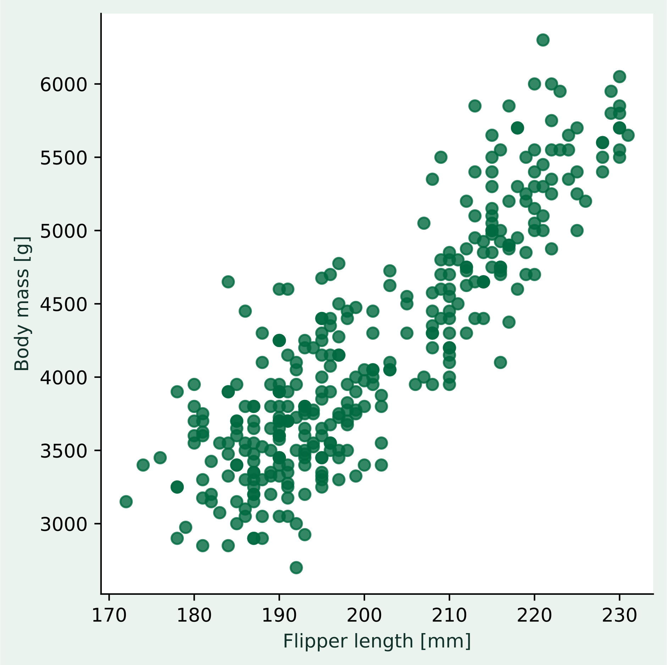
Basics What is “regression”?
Consider the following problem:
We have measurements of the flipper length and the body mass of penguins
We suspect that there is some kind of relationship between the two variables
Formulating a causal, biologically-motivated model for this relationship seems difficult
Instead, we try to somehow learn the “rules” for the association from the data itself (supervised learning)

Slide 17
Basics Regression problem or not?
Definition:
We use regression models to associate one or more independent variables with a continuous-valued dependent variable without knowing the rules for this association.
Activity: Which of these problems could we tackle with a regression model?
Predicting if a customer will buy a product based on their previous purchase history.
Predicting a student’s college GPA based on their high school GPA and SAT score.
Predicting the distance traveled by a spaceship based on time.
Predict the load of a server based on time.
Predicting a company’s revenue based on its advertising expenditure.
Predict the value of a house based on its features.

Slide 18
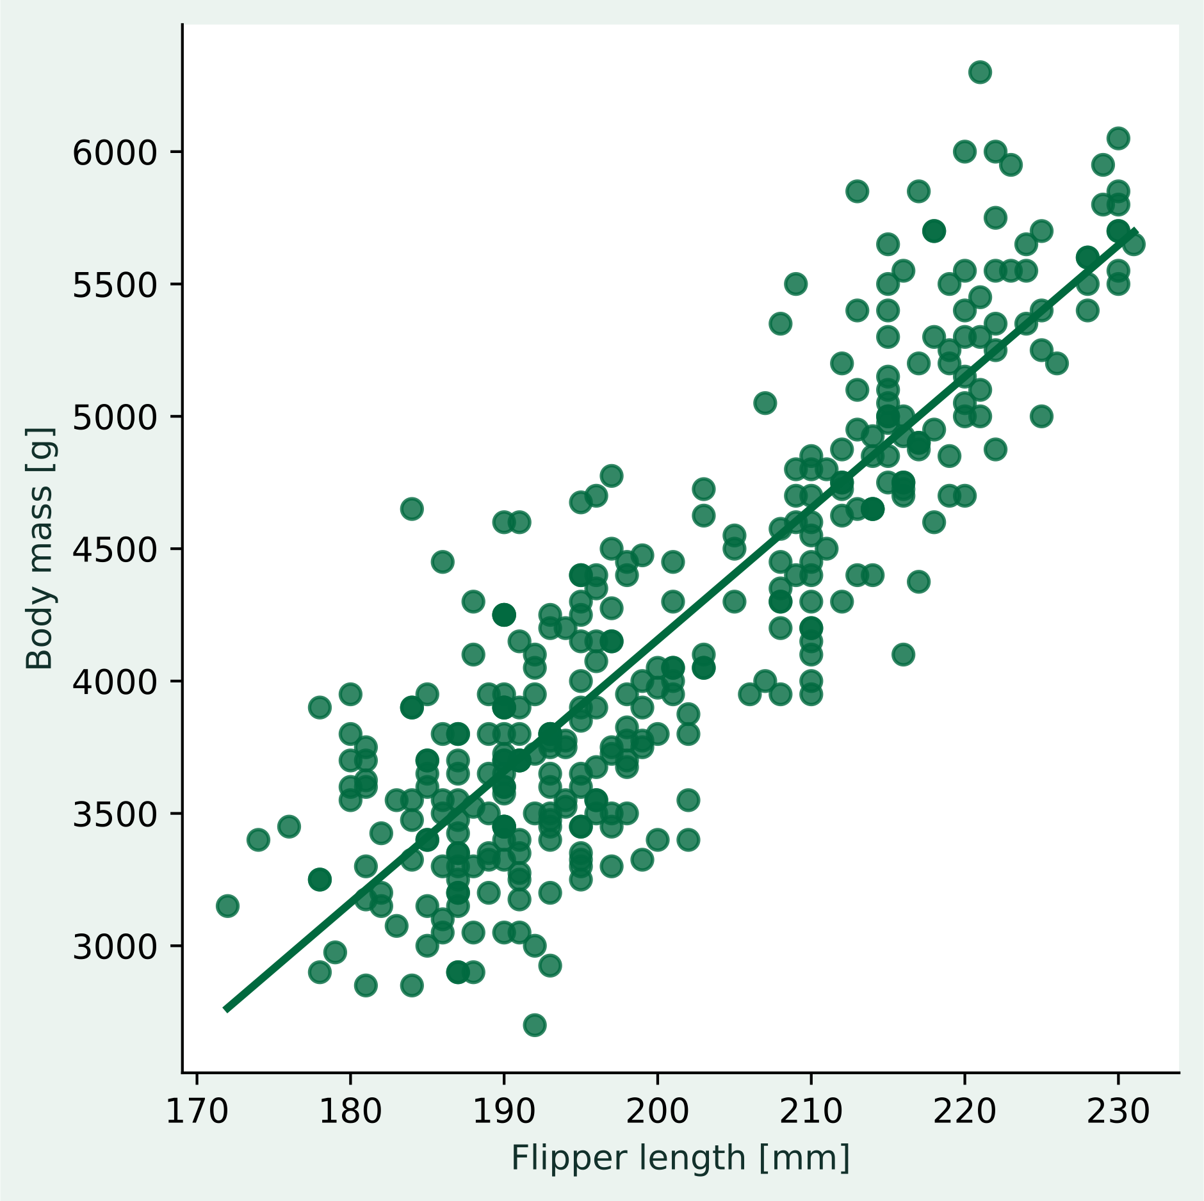
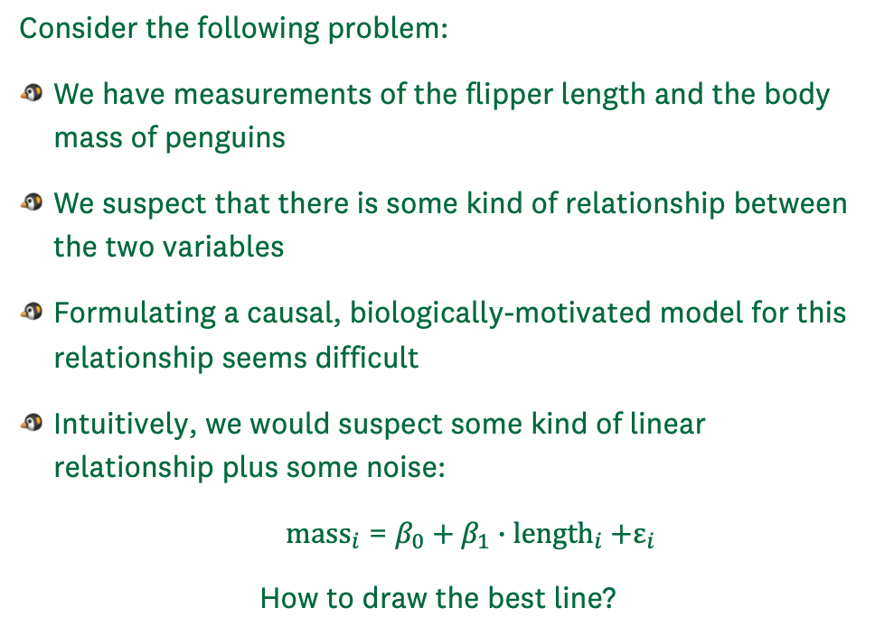
Best-fit models Linear Regression – The Art of Drawing a Line
Consider the following problem:
We have measurements of the flipper length and the body mass of penguins
We suspect that there is some kind of relationship between the two variables
Formulating a causal, biologically-motivated model for this relationship seems difficult
Intuitively, we would suspect some kind of linear relationship plus some noise:
${\text{mass}}_{i}$ = $β_{0}+β_{1}∙{\text{length}}_{i}\text{ +}ε_{i}$
How to draw the best line?

Slide 19

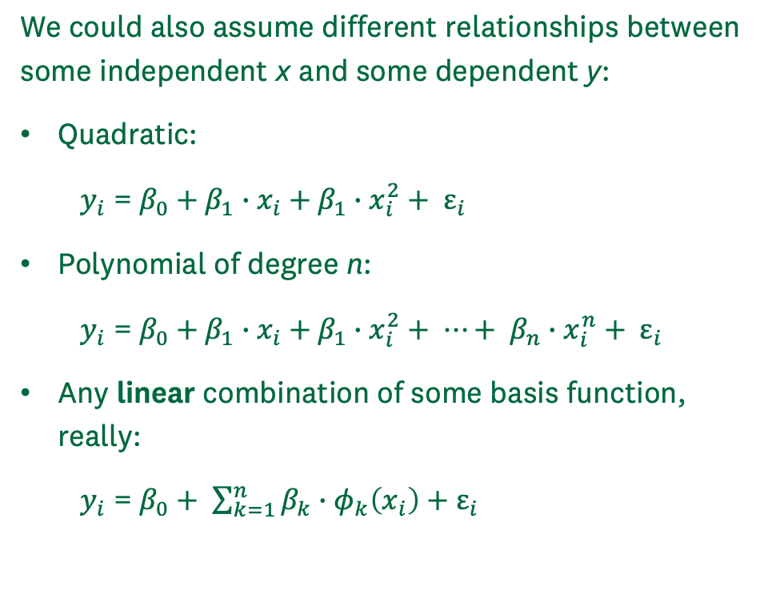
Best-fit models Linear Regression – The Art of Drawing a Line
We could also assume different relationships between some independent x and some dependent y:
Quadratic:
$y_{i}$ = $β_{0}+β_{1}∙x_{i}\text{ +} β_{1}∙x_{i}^{2}+ ε_{i}$
Polynomial of degree n:
$y_{i}$ = $β_{0}+β_{1}∙x_{i}\text{ +} β_{1}∙x_{i}^{2}+ ⋯+ β_{n}∙x_{i}^{n}+ ε_{i}$
Any linear combination of some basis function, really:
$y_{i}$ = $β_{0}+ \sum_{k=1}^{n}{β_{k}∙φ_{k}\left(x_{i}\right)}+ε_{i}$
n = 2

Slide 20

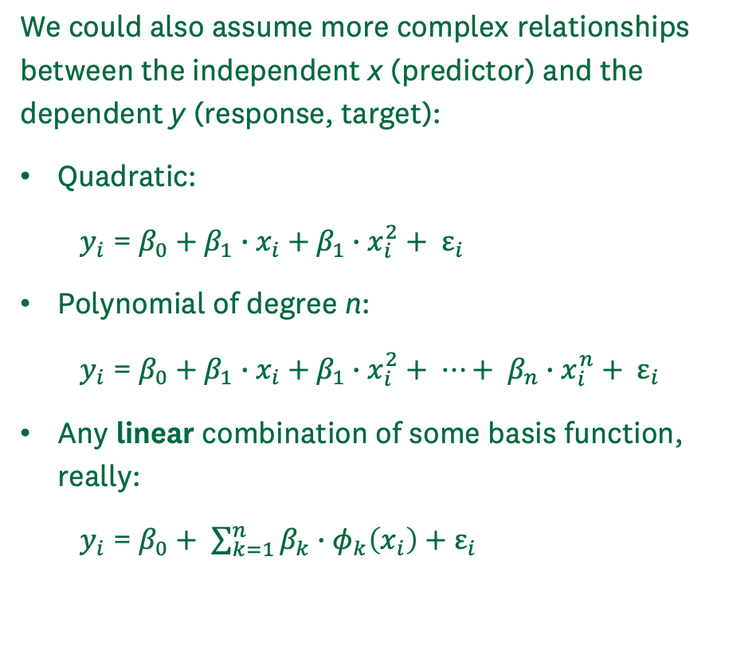
Best-fit models Linear Regression – The Art of Drawing a Line
We could also assume more complex relationships between the independent x (predictor) and the dependent y (response, target):
Quadratic:
$y_{i}$ = $β_{0}+β_{1}∙x_{i}\text{ +} β_{1}∙x_{i}^{2}+ ε_{i}$
Polynomial of degree n:
$y_{i}$ = $β_{0}+β_{1}∙x_{i}\text{ +} β_{1}∙x_{i}^{2}+ ⋯+ β_{n}∙x_{i}^{n}+ ε_{i}$
Any linear combination of some basis function, really:
$y_{i}$ = $β_{0}+ \sum_{k=1}^{n}{β_{k}∙φ_{k}\left(x_{i}\right)}+ε_{i}$
n = 5

Slide 21
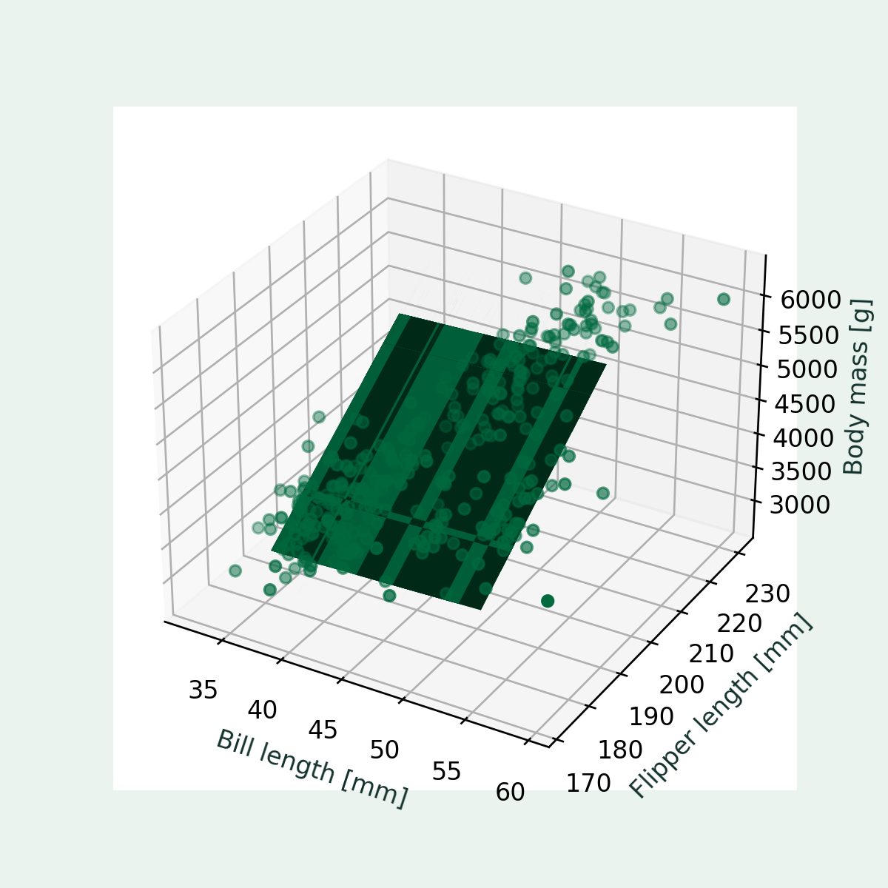
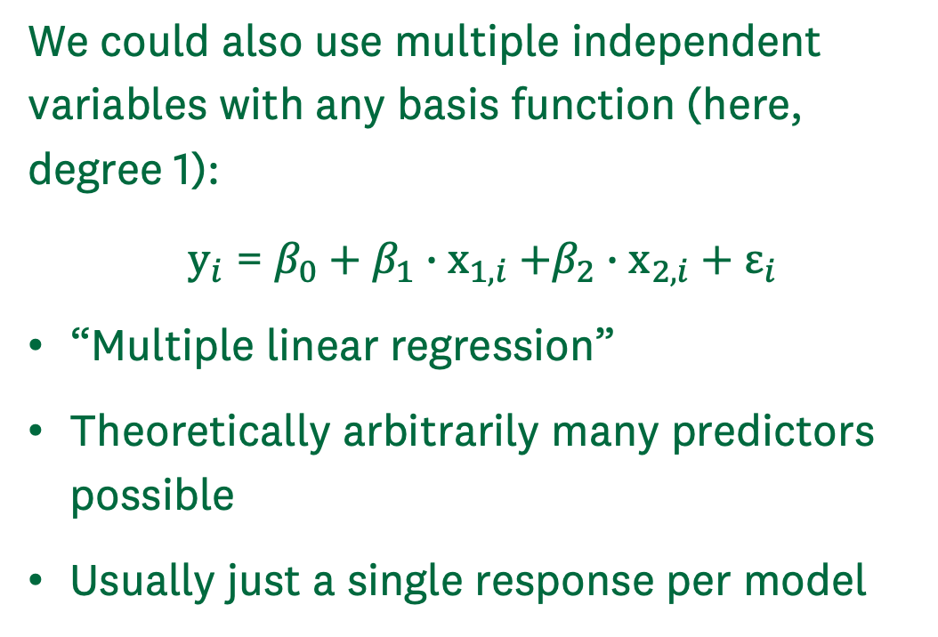
Best-fit models Linear Regression – The Art of Drawing a Line
We could also use multiple independent variables with any basis function (here, degree 1):
${\text{y}}_{i}$ = $β_{0}+β_{1}∙{\text{x}}_{1,i}\text{ +}β_{2}∙{\text{x}}_{2,i}+ε_{i}$
“Multiple linear regression”
Theoretically arbitrarily many predictors possible
Usually just a single response per model

Slide 22
Best-fit models Linear Regression – Survival of the best fit
Activity:
Where would you draw the line?
How could you be sure that it is “the best line”?

Slide 23
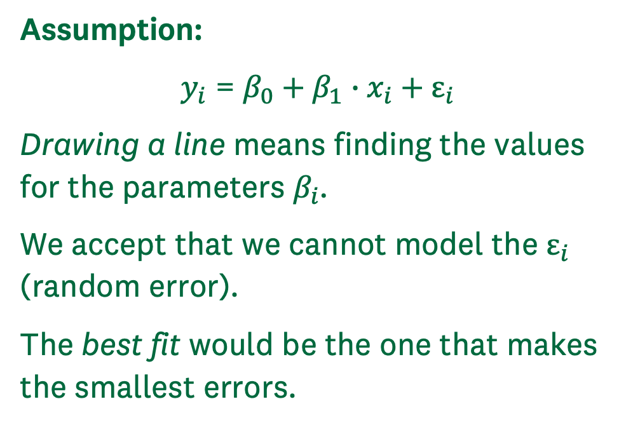
Best-fit models Linear Regression – Survival of the best fit
Assumption:
$y_{i}$ = $β_{0}+β_{1}∙x_{i}\text{ +} ε_{i}$
Drawing a line means finding the values for the parameters $β_{i}$.
We accept that we cannot model the $ε_{i}$ (random error).
The best fit would be the one that makes the smallest errors.

Slide 24
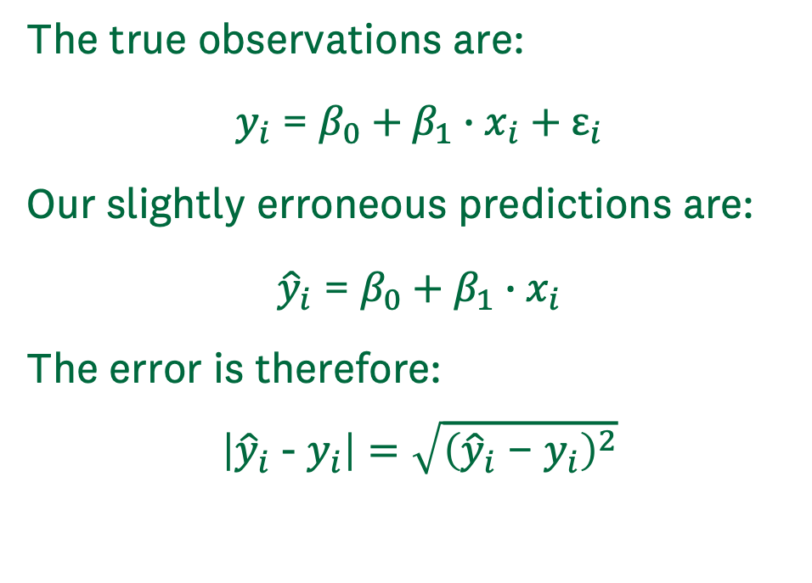
Best-fit models Linear Regression – Survival of the best fit
The true observations are:
$y_{i}$ = $β_{0}+β_{1}∙x_{i}\text{ + }ε_{i}$
Our slightly erroneous predictions are:
${\hat{y}}_{i}$ = $β_{0}+β_{1}∙x_{i}$
The error is therefore:
$$\left|{\hat{y}}_{i}\text{ - }y_{i}\right|=\sqrt{{\left({\hat{y}}_{i}\text{ − }y_{i}\right)}^{2}}$$

Slide 25
Best-fit models Linear Regression – Survival of the best fit
We can pick some values for beta
Calculate the error and plot it
Pick some other values and repeat
We can see a minimum, so there is a best fit!

Slide 26
Best-fit models Linear Regression – Survival of the best fit
Calculate derivatives, set to 0, solve equation

Slide 27
Best-fit models Overfitting

Slide 28
Similarity-based models k-Nearest Neighbors Regression

Slide 29
Beyond this session The many, many, MANY kinds of regression models

Slide 30
Case study Diamond price prediction

Slide 31
Critical thinking Regression
Is the model’s basis function a reasonable choice?
Is the model complexity adequate?
Is there evidence for overfitting?

Slide 32
Summary Key take-aways

Slide 33
References

